Slide 1
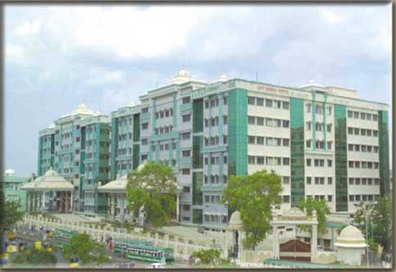
Cardinal symptoms in cardiology
. . . an analysis
Dr S Venkatesan .MD,DM
Madras Medical college
SIMS March 4 th 2016

Slide 2
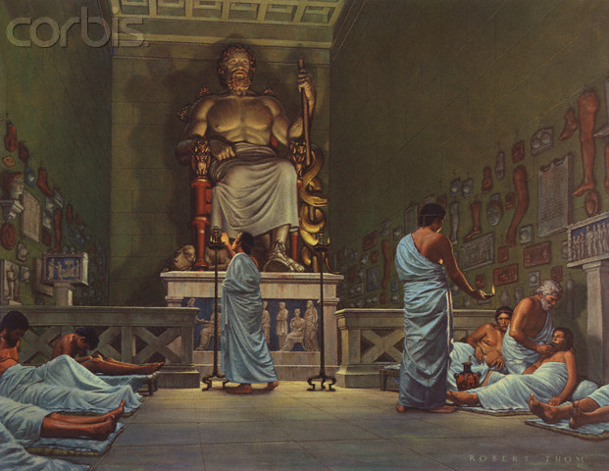
Ancient medicine

Slide 3
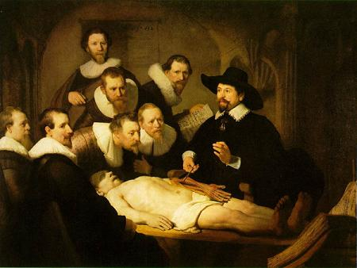
Early scientific medicine

Slide 4
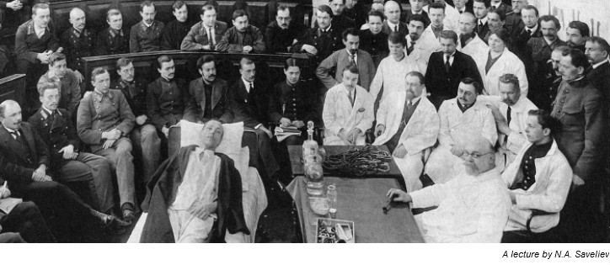
Emergence of modern medicine

Slide 5
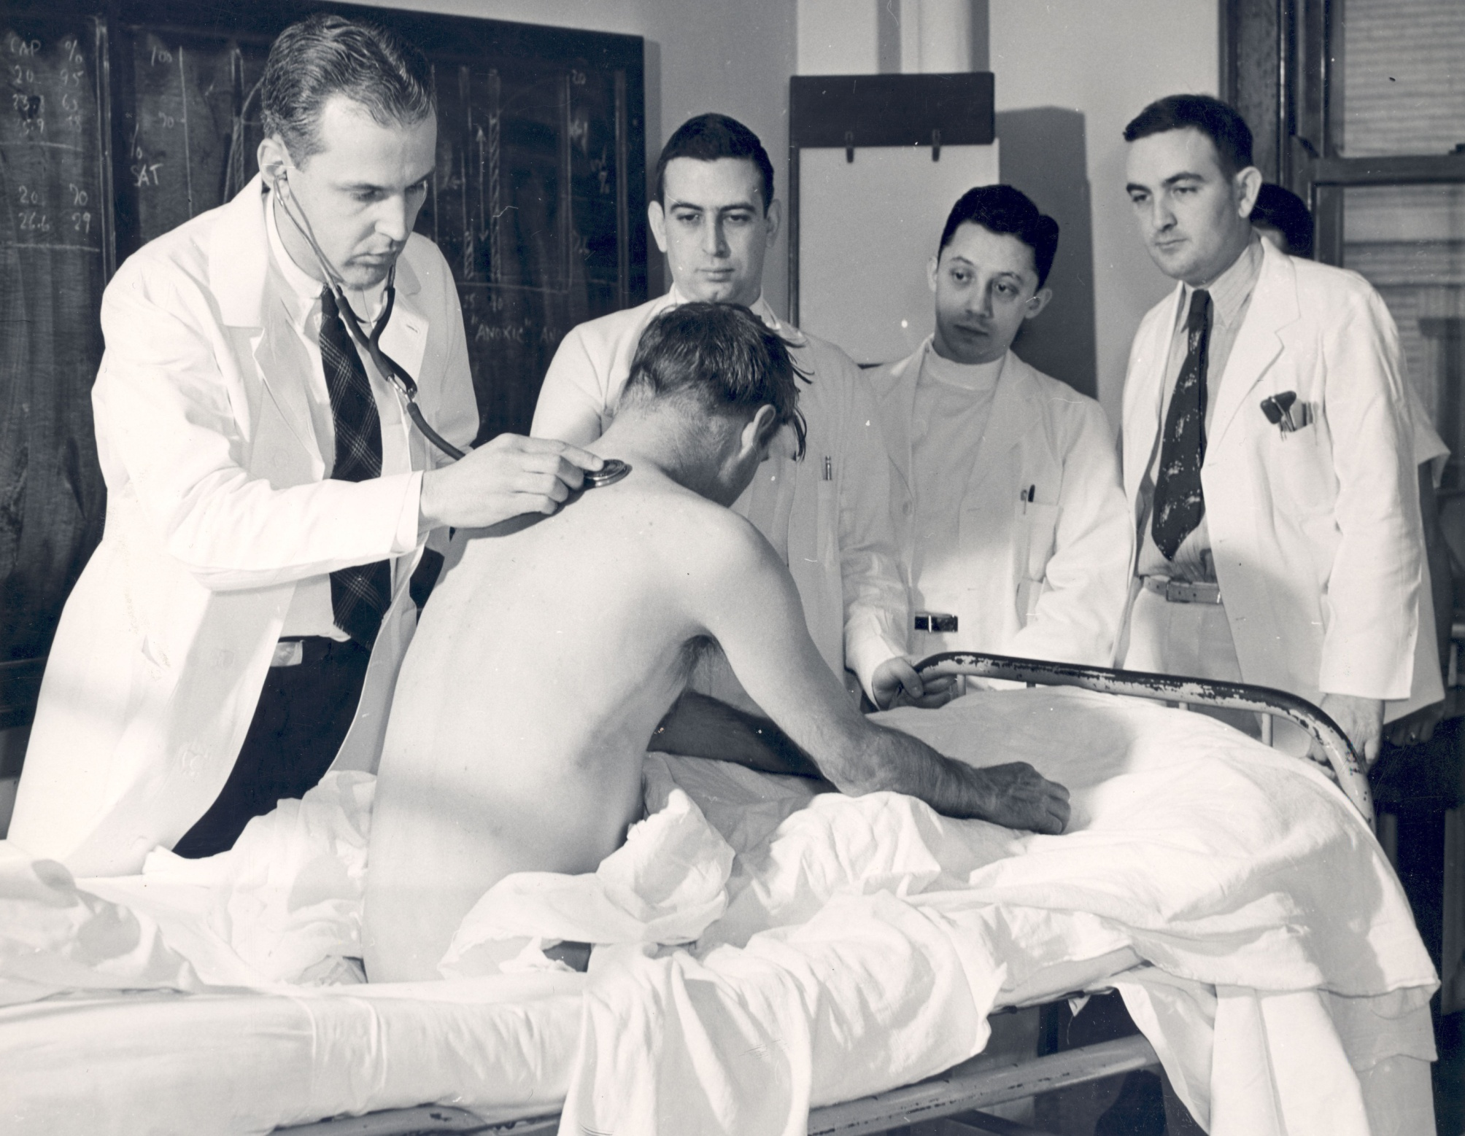
Bed side medicine

Slide 6
Moving away . . . Again

Slide 7
Gadget guided medical teaching !

Slide 8
William Osler (1849-1919)
"Listen to your patient, he is telling you the diagnosis,”

Slide 9
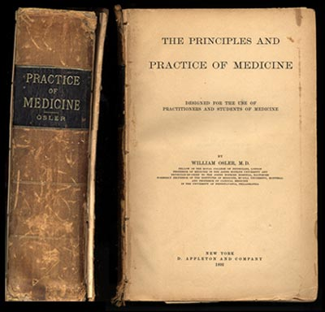

Slide 10
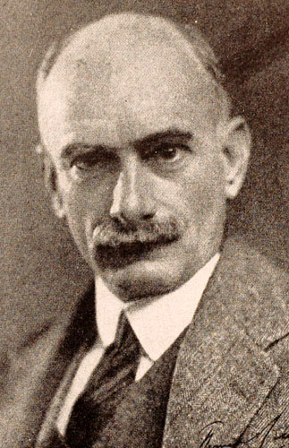
“The very essence of cardiovascular medicine is the recognition of early heart failure !
Sir Thomas Lewis 1881 –1945

Slide 11
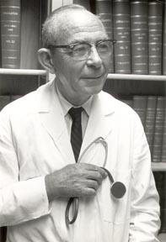
Tinsley Harrison
1900-1978
University of Alabama

Slide 12
Cardinal symptoms
Dyspnea
Chest pain
Palpitation
Syncope
Fatigue

Slide 13
Dyspnea
Palpitation
Chest pain
syncope

Slide 14
Valvular
Myocardial
Pericardial
Non cardiac
Systemic

Slide 15
Dyspnea and Mechanism of Dyspnea

Slide 16
DEFINITIONS OF DYSPNEA
conscious sensation that results from an unusual perception of discomfort during breathing.
Heart Failure- A Companion to Braunwald
abnormally uncomfortable awareness of breathing
Harrison's Principles of Internal Medicine, 16th Edition

Slide 17
Dyspnea
Grading
Mechanism
Timing
Onset/offset
Heart vs Lung
Localizing value
Systemic (Anemia etc)

Slide 18
Grading of dyspnea
NYHA
MRC
ATS
Borg
Yale
Minnesota
Subjective vs Objective

Slide 19
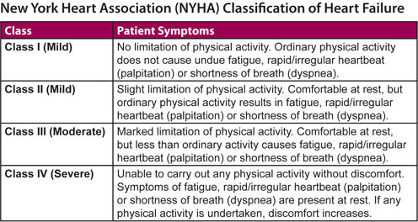

Slide 21
MECHANISMS OF DYSPNEA

Slide 22
DYSPNEA INVOLVES
CENTRAL,
PERIPHERAL,
CHEMORECEPTOR MECHANISMS.

Slide 23
High control of sensory cortex
Conscious
Interinduvidual variation
Sensory cortex
Psychological

Slide 24
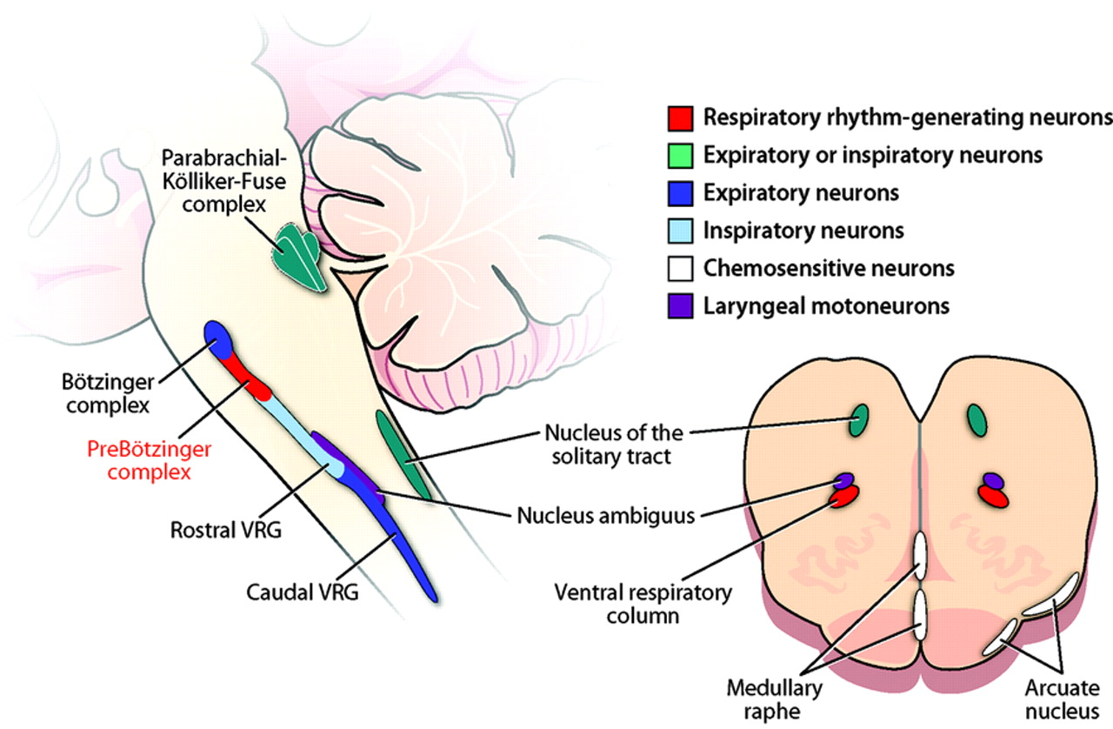

Slide 25
Intrathoracic Receptors
J Receptors or Pulmonary C fiber receptor
Pulmonary strech receptors
Lung irritant receptors
Pulmonary arterial baroreceptors

Slide 26
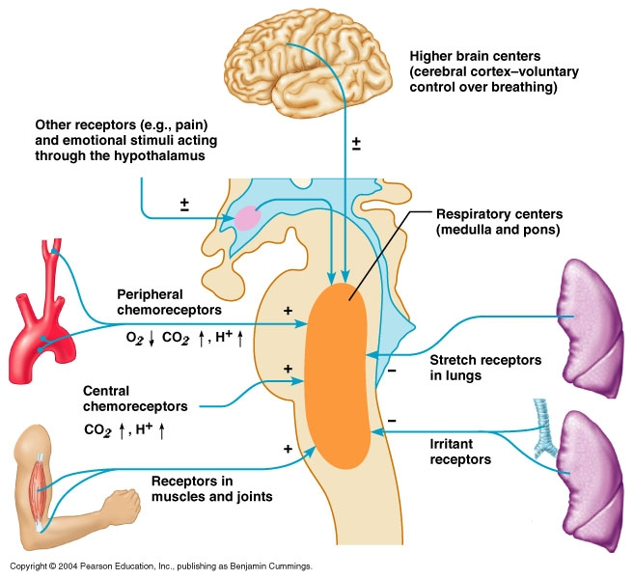

Slide 27
General mechanisms of dyspnea
Decreased Lung compliance
Decreased air volume
Increased Airway resistance
Respiratory muscle fatigue

Slide 28
Suggestive of pulmonary
Cough with expectorant
Wheezing
Fever
Weight loss
Pleuritic type of pain
Seasonal variation
Responds to bronchodilator

Slide 29
Suggestive of cardiac
PND and orthopnea
Associated syncope, palpitation, anginal pain
Rapid progression of symptoms
Little cyanosis with severe dyspnea
Response to diuretics
Chyne-stroke breathing

Slide 30
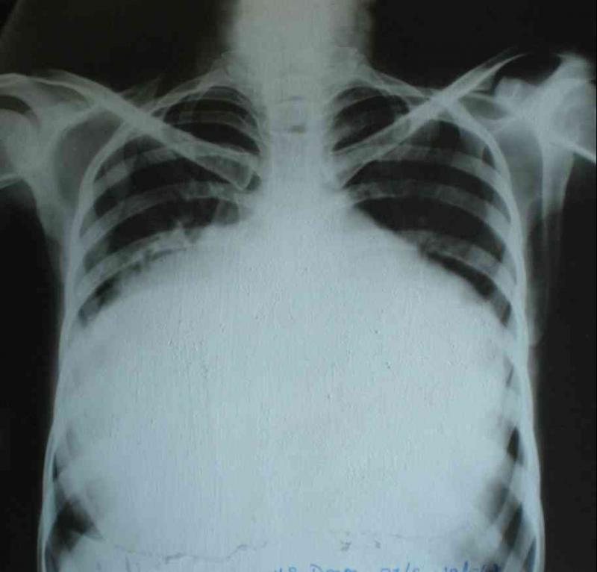
Massive cardiomegaly : When heart encroach lungs . . .

Slide 31
LIKELY MECHANISMS IN SELECTED CONDITIONS

Slide 32
Does dyspnea has localising value ?
Left heart
Right heart

Slide 33
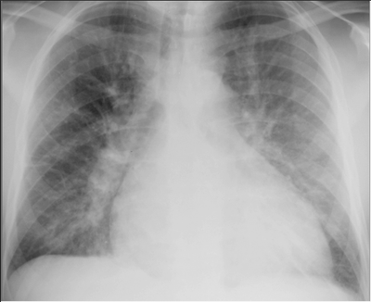

Slide 34
Mechanism of PAROXYSMAL NOCTURNAL DYSPNEA
Depression of respiratory centre
CATECHOLAMINE SURGE (?night mare)
Augmented venous return from lower limbs-pulmonary and capillary pressure increases –increase interstitial edema(Slow redistribution)

Slide 35
Mechanism in Orthopnea
Augmented venous return
pulmonary and capillary pressure increases
interstitial edema (fast Redistribution)-400 ml
Elevation of diaphragm
Occur 1-2 min of recumbency
Improves on sitting up

Slide 36
Grading PND and orthopnea :Where does it fit in NYHA ?

Slide 37
PND –New observations
Acute diastolic dysfunction
Reversible episodes of Pulmonary edema
PCWP variable
Hidden CAD commoner than expected
Some events may precipitate an ACS (Circadian)

Slide 38
Dyspnea and LVEDP relationship ?
Dyspnea in systolic vs diastolic dysfunction ?

Slide 39
Dyspnea in Right heart disease
Always difficult to explain
Dead space increased
Low V/Q
Respiratory muscle fatigue
PFO
RV dysfunction –(RV stretch receptors ?)

Slide 40
Dyspnea in congenital heart disease
TOF
Biochemical (Hypoxic)
RV dysfunction ?
Exertional vs rest
Multi factorial

Slide 41
Other forms of dyspnea
Platypnea: dyspnea in upright position (Pul.embolism)
Trepopnea: dyspnea in one lateral decubitus position (Mobile clots)
Dyspnea Equivalent

Slide 42
Dyspnea equivalent ?
Cough
Extreme fatigue
Other signs of hypoxia
Violent behavior , ACS delirium
Elderly /lacunar infarct / Selective right amygdala lesion may mask dyspnea

Slide 43
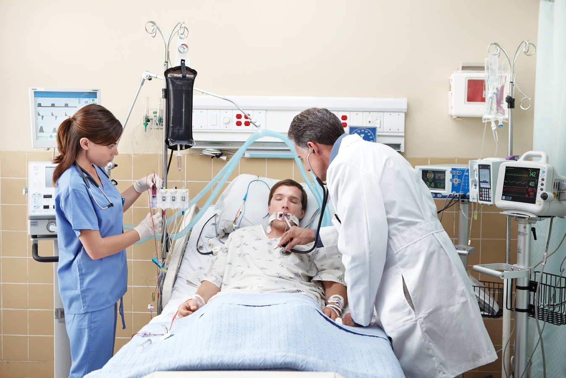
Acute dyspnea in ICU
Don’t blame the heart always
In an Anemic patient with COPD and CKD with LV dysfunction and who is hypoxic
What is the mechanism of dyspnea ?

Slide 44
Biochemical screening for dyspnea ?
Can NT-Pro BNP beat clinical Acumen ?

Slide 45
Dyspnea – Summary
A non specific entity ?
Brings bulk of the heart ailment to a physician
Mechanism are varied
Systemic factors are common
Try to localize the origin from the heart

Slide 46
Fatigue

Slide 48
Fatigue
Physical vs Mental
Efficacy of the effector muscle
Mismatch of cardiac output during exercise,
Muscle and microcirculatory deconditioning,
Neuroendocrine dysfunction.(TNF)
Associated metabolic disorders.

Slide 49
Chest pain

Slide 50
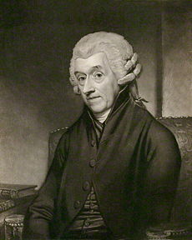
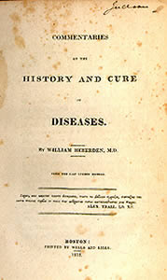
“Dolor pectoris" to the Royal College of Physicians in 1768

Slide 51
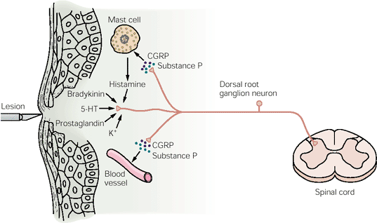

Slide 52
Chest Pain - Genesis
Original Sensation
Reaction to that sensation
(Strongly Influenced by Autonomic /Cortical Influence)
Visceral pain - Type C unmylinated fibres
Cutaneous pain – Fast myelinated fibres

Slide 53
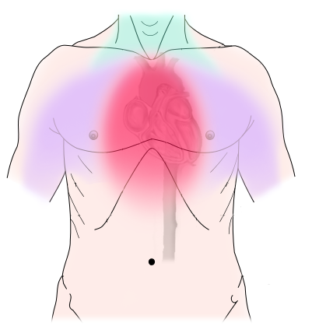
Compressing
Constricting
Squeezing
Strangling
Band like
Non cardiac : Pricking / Lightening /Catching

Slide 54
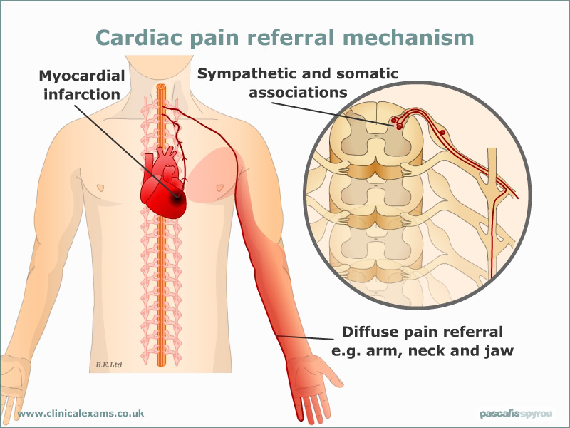

Slide 55
T1 - T5 segments ( Range C3 -T10)

Slide 56
Chest pain
Anginal
Non Anginal
Non Cardiac
Typical
Atypical

Slide 57
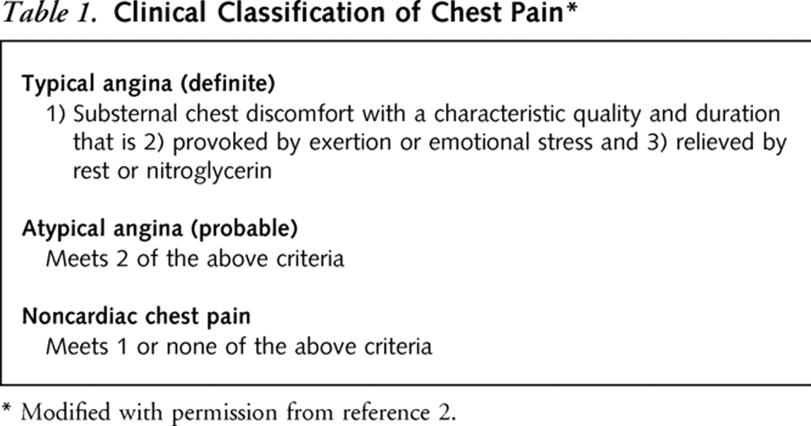

Slide 58
Diamond and Forrester NEJM 1979 Prediction rule
Typical Angina | 90%
Atypical Angina | 50%
Non Cardiac | 16%
Asymptomatic | 3-4%

Slide 59
Acute coronary pain syndromes
Pre- Infarction angina vs Infarct pain
Post infarction angina
Re-infarction
Pericarditis
Infarct expansion
Coronary dissections/Plaque fissure /Ruptures

Slide 60
Pre-infarction Angina
vs
Infarct pain
Time window errors !

Slide 61
Associated phenomenon
Sympathetic
Anxiety /Fear/ tachycardia/Sweating
Hypertension
Parasympathetic
Nausea/Vomiting/ Bradycardia/Hypotension

Slide 62
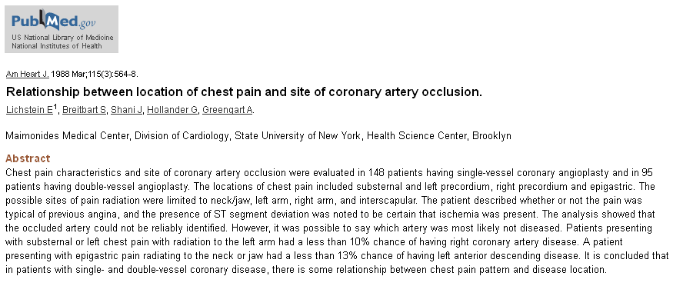
Localising value of Angina
RCA vs LAD ?
Epigastric –Jaw-neck – 90% RCA

Slide 63
Chest pain :Clinical vs Physiological discrepancy

Slide 65
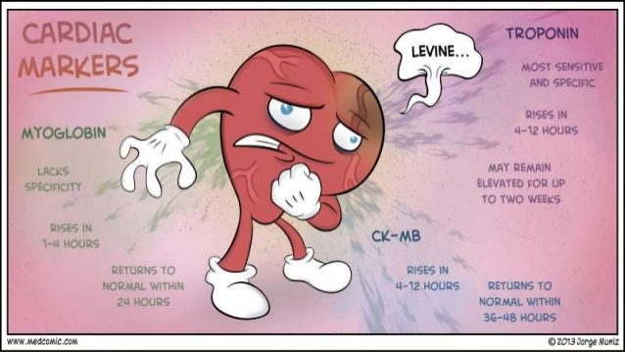
Troponin –VE STEMI ?

Slide 66
Special Types of Angina
Post prandial angina
(Diversion of blood/ Left main/Spasm)
Nocturnal Angina –AR/REM sleep
Walkthrough /Golfer -Precondtioning
Linked Angina –GE/Cervical

Slide 67
Non Ischemic cardiac pain

Slide 68
Pericarditis
Dissection
Acute pulmonary HT
Infective endocarditis
MVPS
Myocardial stretch

Slide 69
Pericardial pain
Sharp
Postural
Pleuritic component
Very rare to radiate to hand
Diaphragmatic surface –Refers to neck

Slide 70
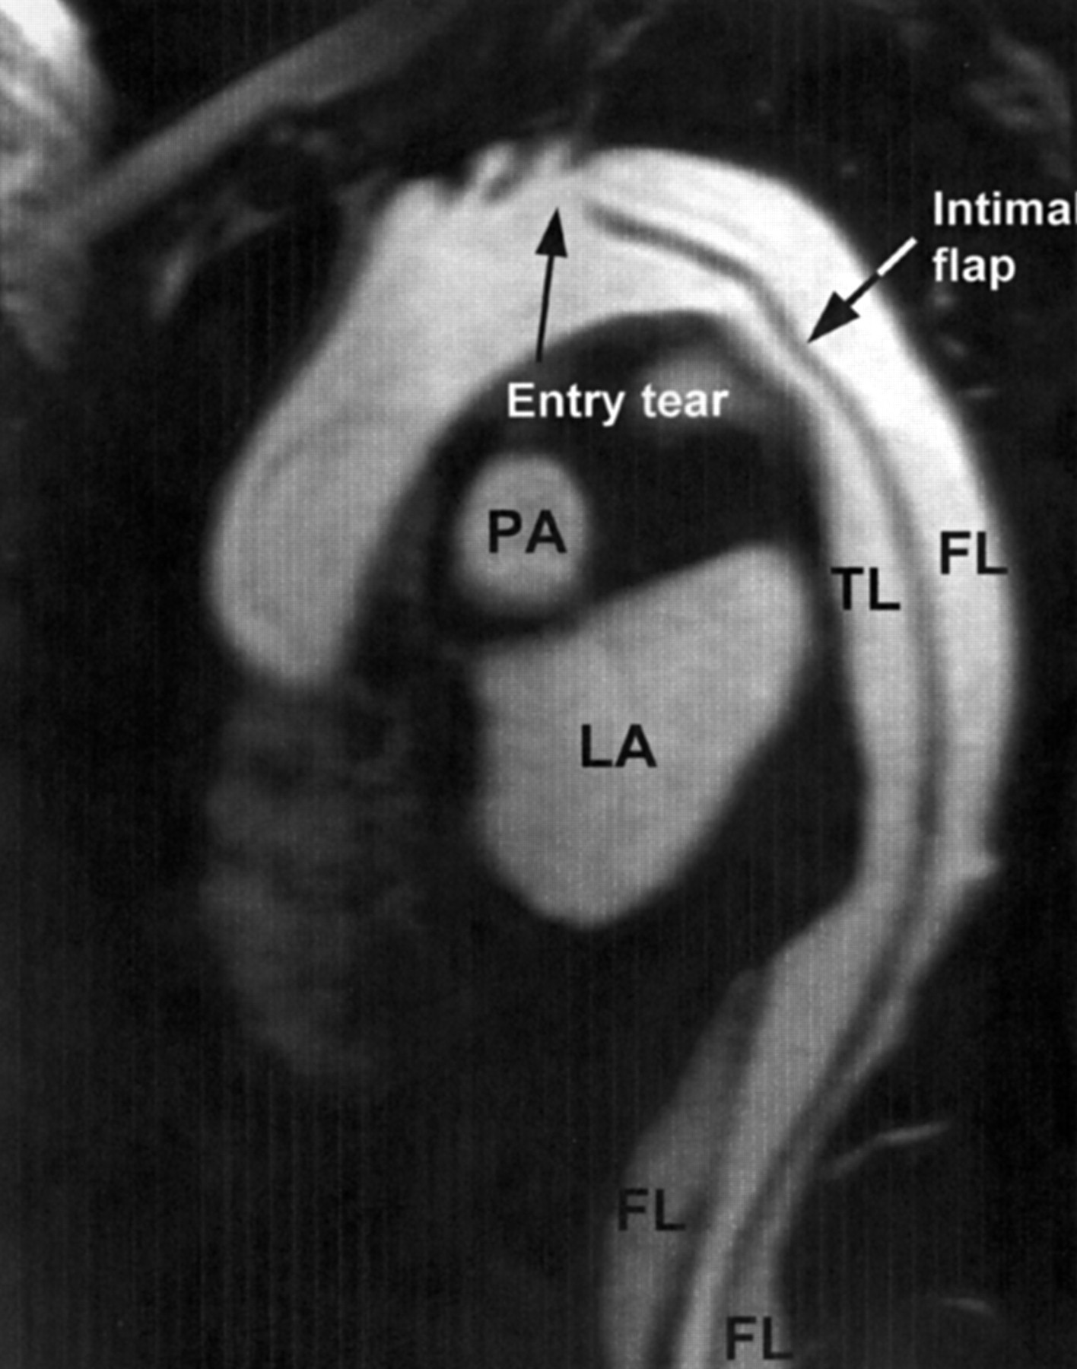
Chest pain of dissection
Mayo Clin Proc. 1993 Jul;68(7):642-51.Clinical features and differential diagnosis of aortic dissection: experience with 236 cases (1980 through 1990).
Spittell PC¹, Spittell JA Jr, Joyce JW, Tajik AJ, Edwards WD, Schaff HV, Stanson AW.

Slide 71
Anginal equivalents
Diabetics
In elderly with autonomic dysfunction
Patients with chronic beta blocker and other anti anginal drugs.
Post PCI/CABG patients Denerved heart blocks pain ?

Slide 72
Chest pain evaluation – Summary
Most important symptom
Quiet challenging in triaging
Combination of cardiac /Non cardiac rampant
Still a Vital job for the physician
Be meticulous and listen . . .
Even an Instant CAG is not going to the answer your suspicion ? As we often struggle with FFR data in cath lab with 70% lesion !

Slide 73
Palpitation

Slide 74
Palpitation
Onset /offset
Duration
Exertion
Regularity
Associated chest pulsation

Slide 75
Anatomical and Physiological basis
Valve motion
Hyperdynamic heart
Myocardium vs Chest interface
Thin chest augments
*AML movement –AML

Slide 76
Palpitation –Etiological basis
Valvular (Stenotic vs Regurg)
Arrhythmic
Combined
Hyperdynamic states
Non cardiac
Primary myocardial cause rare : Generally for palpitation to occur there should be well preserved LV function

Slide 77
Mechanism of palpitation in VPDs
Missed beat
Skipped beat
Extra beat ?
Post VPD potentiation

Slide 78
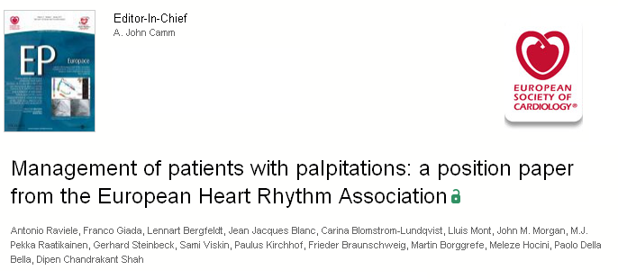

Slide 79
Syncope

Slide 80
DEFINITION
Syncope is- transient loss of consciousness (LOC)
caused by transient global cerebral hypoperfusion
Characterized by rapid onset,short duration, and spontaneous recovery

Slide 82
Conditions incorrectly diagnosed as syncope

Slide 83
Syncope
Prodrome
Exertional /Non exertional
Post Syncope rhythm

Slide 84
Neural circuits : Neuro cardiogenic syncope
Heightened Sympathetic tone
Cardiac (stretch )
Reflex parasympathetic overshoot
(Cardio Inhibitory/Vasodepressive)

Slide 85
Types of syncope
Neurocardiogenic syncope
Cardiac (Arrhythmic /Non arrhythmic)
Stoke Adams syncope
RVOT vs LVOT syncope
Why syncope is rare even in critical Mitral stenosis ?

Slide 86
Cardinal symptoms
Concluding remarks

Slide 87
Symptoms , Signs , Structural basis are closely linked !
Dyspnea
Palpitation
Chest pain
syncope
If there is dispute . . . symptoms shall prevail over

Slide 88
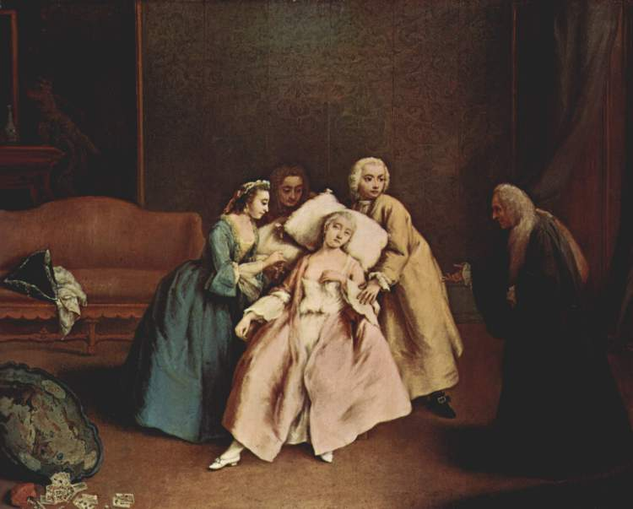
A story of an young women
With syncope
History is most vital in syncope , than any other

Slide 89
She was extensively investigated
HUT , MRI brain , Contrast echo , Loop recorders , And visited Neurologist, cardiologist , and finally, It was learnt she just gets giddy and is not really syncope . Whenever she sees blood which started first when her pet dog was injured !

Slide 91
History if you miss initially
It is very unlikely you are going to course correct till every thing is over !

Slide 92
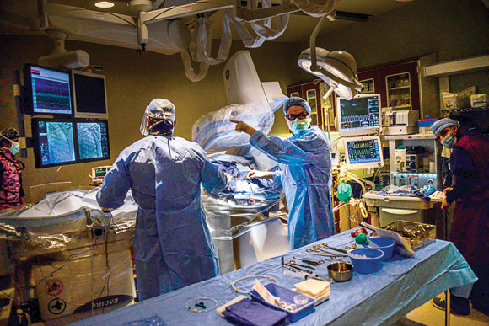
We can be modern in our approach . . .

Slide 93
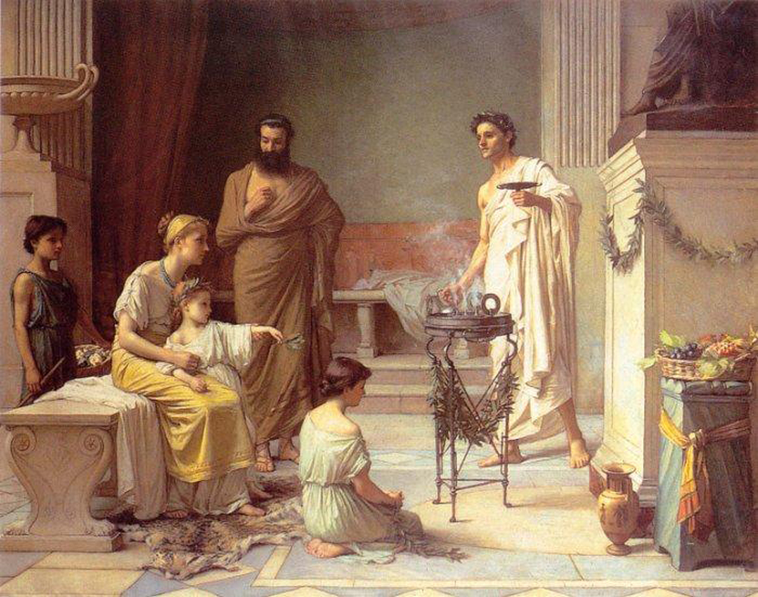
Clinical medicine may appear of Heritage value , still it is the life line of medicine , It is being threatened , but It’s still in our hands . . .We shall decide the destiny !

